Slide 1

Betwixt 1.0 Team Members: Alicia Rodriguez, Alejandro Palacios, Daniel Raad Product Owner: Joseph Cutrono Professor: Masoud Sadjadi School of Computing and Information Sciences Florida International University
Senior Project Final Presentation Fall 2017
December 1st, 2017
Notes:
Greet your audience, thank them for attending your presentation, introduce yourself, introduce your project, introduce your team members, and quickly indicate what each of you did in a high-level manner, and put more emphasis on your part/contribution.

Slide 2
Problem Definition
An iOS and Android application which calculates the central location among users and suggests locations to meet up.
Notes:
Introduce the problem that the whole project tackles and stay focused on the parts that you have been working. Indicate if there is an existing previous system, enumerate its problems/limitations, etc.

Slide 3
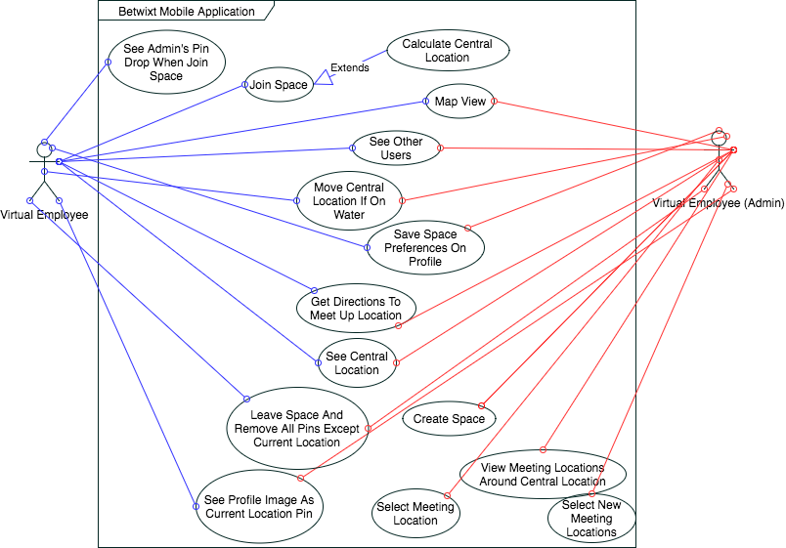
Requirements: Use Cases
Notes:
4. Requirements:
4.1. User stories implemented (one or more slides).
4.2. UML use cases and the use case diagram for the implemented use cases (one or more slides).
4.3. UML sequence diagrams for the implemented use cases.

Slide 4






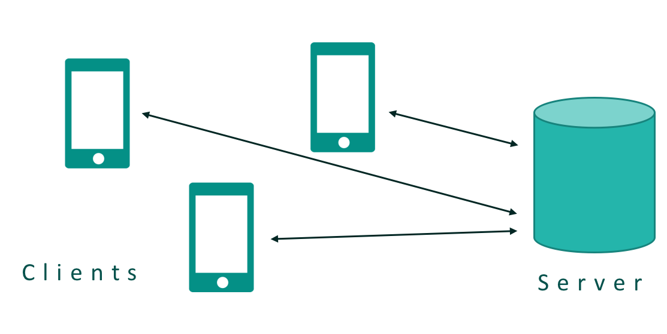
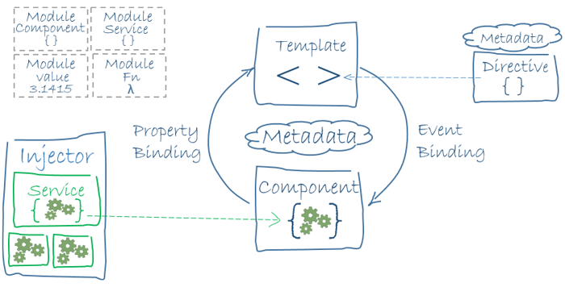
System Design: Architecture
Front End
Back End
Notes:
5. System design:
5.1. System decomposition; identify the architecture patterns used (one slide).
5.2. System deployment – h/w and s/w requirements (one slide).
5.3. Persistent data design (one slide).
5.4. Security/Privacy (one slide).

Slide 5
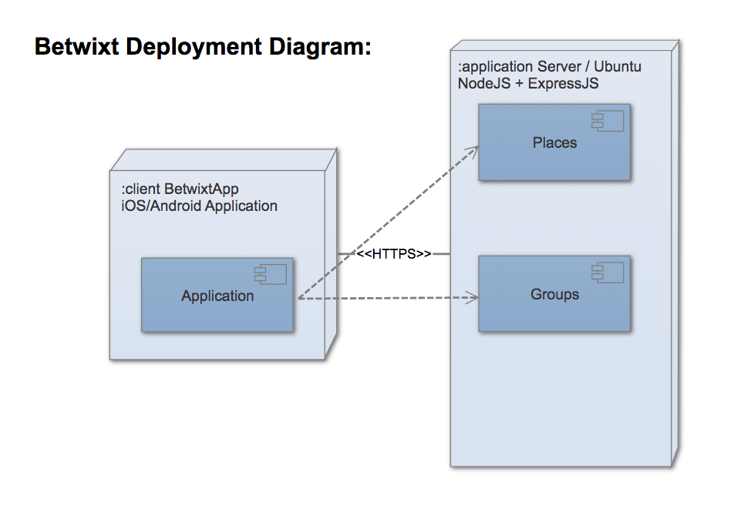
System Design: Deployment
Notes:
5. System design:
5.1. System decomposition; identify the architecture patterns used (one slide).
5.2. System deployment – h/w and s/w requirements (one slide).
5.3. Persistent data design (one slide).
5.4. Security/Privacy (one slide).

Slide 6
Requirements: User Stories
Feature <684> Give User Locations To Meet
Description:
As a user (admin of space), I want to see a list of suggestions for places to meet up and select that place.
Acceptance Criteria:
Show a list of suggestions as well as how far it is from central location
Drop pin on the selected suggestion (the admin can only pick the suggestion)
Notes:
4. Requirements:
4.1. User stories implemented (one or more slides).
4.2. UML use cases and the use case diagram for the implemented use cases (one or more slides).
4.3. UML sequence diagrams for the implemented use cases.

Slide 7
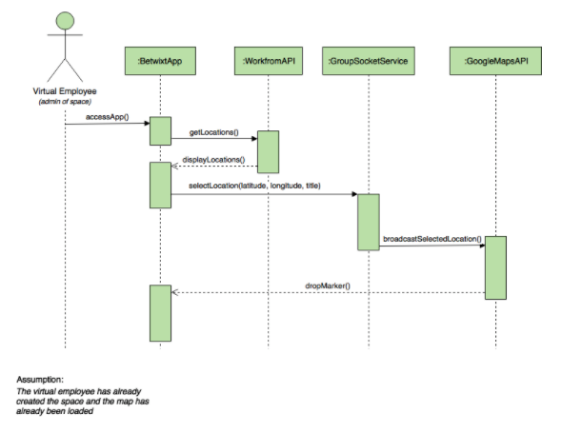
Requirements: Sequence Diagrams
Notes:
4. Requirements:
4.1. User stories implemented (one or more slides).
4.2. UML use cases and the use case diagram for the implemented use cases (one or more slides).
4.3. UML sequence diagrams for the implemented use cases.

Slide 8
Requirements: User Stories
Feature <677> Join a Group
Description:
As a User I would like to be able to join a group so that other members can see my location and I could see theirs.
Acceptance Criteria:
When I click on a deep link, the app will open and will show other group member’s locations as pins on the map.
Notes:
4. Requirements:
4.1. User stories implemented (one or more slides).
4.2. UML use cases and the use case diagram for the implemented use cases (one or more slides).
4.3. UML sequence diagrams for the implemented use cases.

Slide 9
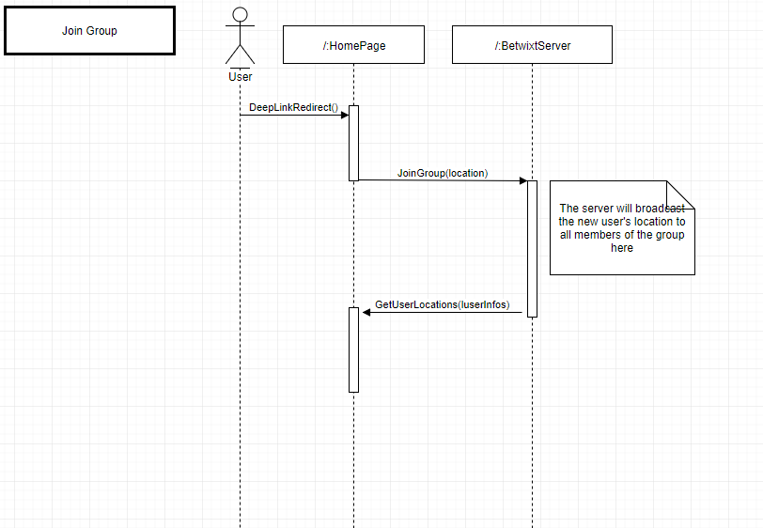
Requirements: Sequence Diagrams
Show the sequence diagram of the most significant use case.
Notes:
4. Requirements:
4.1. User stories implemented (one or more slides).
4.2. UML use cases and the use case diagram for the implemented use cases (one or more slides).
4.3. UML sequence diagrams for the implemented use cases.

Slide 10
Requirements: User Stories
Feature <686> Detect if central location is in water
Description:
As a User I would like to be able to move the central location when it is calculated to be in the ocean so that I may pick a reasonable location to meet up in.
Acceptance Criteria:
Detect that the central location is in water
Inform the user
Allow the user to move the central location in this case
Notes:
4. Requirements:
4.1. User stories implemented (one or more slides).
4.2. UML use cases and the use case diagram for the implemented use cases (one or more slides).
4.3. UML sequence diagrams for the implemented use cases.

Slide 11
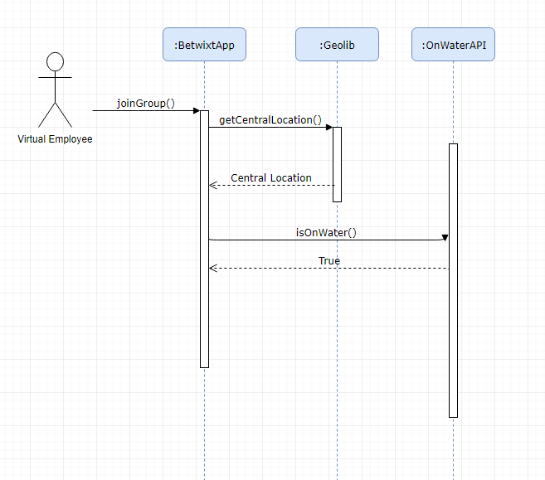
Requirements: Sequence Diagrams
Notes:
4. Requirements:
4.1. User stories implemented (one or more slides).
4.2. UML use cases and the use case diagram for the implemented use cases (one or more slides).
4.3. UML sequence diagrams for the implemented use cases.

Slide 12
Test Cases
Test ID | Precondition | Description | Expected Results | Actual Results | Pass/Fail
feature_684_1 | The user has distributed the space link to others and they have joined | Select a location and drop a red pin on all devices that are connected to that space with the selected location | See the selected location pin on the map | The pin with the selected location was dropped on the map and everyone can see it | Pass
Feature_686_1 | The central location is calculated and it is on water | Central location is movable if it is calculated to be on water | The central location pin becomes movable and can be dragged onto land. | The central location became movable and was able to be moved onto land. | Pass
Notes:
7. Test Suites and Test Cases (one sunny day and one rainy day) for the use case represented in part (5) above (2 slides).
7.1 One sunny day and one rainy day for the implemented use cases (one or more slides).
7.2 Automated test scripts for the implemented use cases (one or more slides).

Slide 13
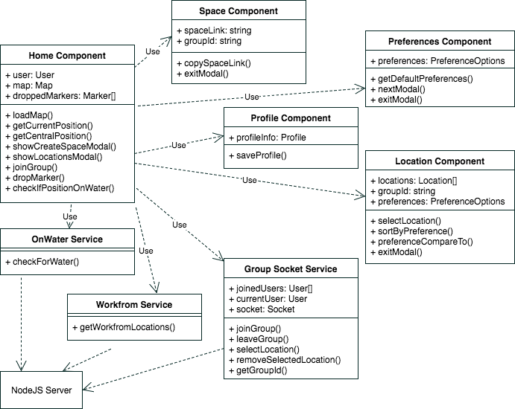
Class Diagram
Notes:
6. Detailed design:
6.1. Minimal class diagram. Identify the design patterns used (one or more slides).
6.2. State machine for the main control object or the most important object of the implemented uses cases (one or more slides).
6.3. Main algorithm used related to an implemented use case described above (one or more slides).

Slide 14
Summary
Betwixt 1.0 was built under an agile development environment, using Scrum. Daily Scrum meetings were held as well as Scrum Ceremonies, such as Retro, Review, and Planning.
Betwixt 1.0 is an iOS and Android application which calculates the central location among users and suggests a location to meet up, tailored to Virtual Employees.
Contact Information
Alicia Rodriguez
arodr967@fiu.edu
Daniel Raad
draad001@fiu.edu
Alejandro Palacios
apala067@fiu.edu
Notes:
Summarize your contribution
Include your contact information
Ask if anyone has any questions for you.
Thank your audience

